Slide 1
Sectional drawing

Slide 7
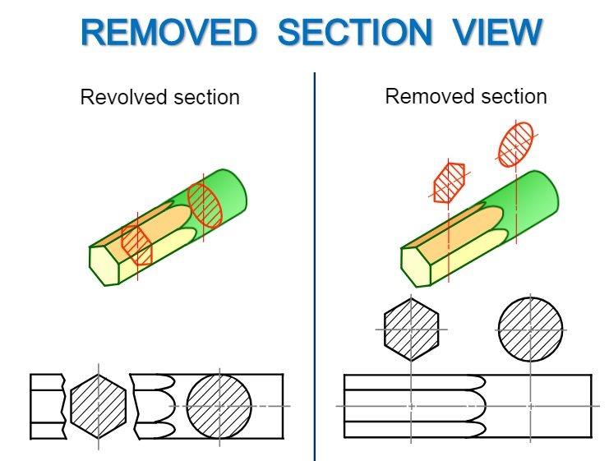

Slide 8
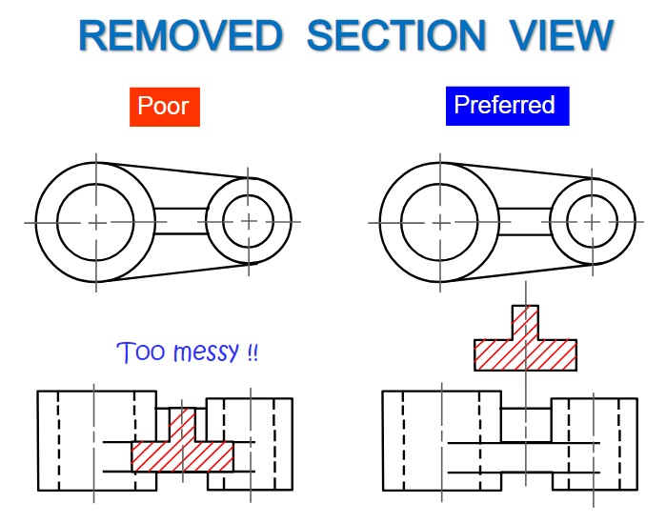

Slide 10
Exercise And
Homework

